Slide 1

DISEASE DATABASE MANAGEMENT
By
Mamatha Singh
Manvitha Karanam
Meher Venkat Karri

Slide 2
Introduction
In Today's rapidly evolving healthcare landscape, managing and understanding diseases effectively is critical for improving patient outcomes and optimizing healthcare resources. With the advent of big data and advanced data analytics, healthcare providers have unprecedented opportunities to enhance diagnostic accuracy, treatment efficacy, and overall healthcare management.
It develops a comprehensive disease management system that leverage a relational database to integrate and analyze patient, disease, medication, and treatment data. This system aims to provide actionable insights that enhance patient care, improve treatment outcomes, and streamline healthcare operations.

Slide 3
Business Problem
Healthcare systems worldwide face challenges in managing disease-related data effectively due to the increasing complexity of patient data and the sheer volume of information. This situation often results in suboptimal patient outcomes, inefficient resource utilization, and increased healthcare costs.
Solution:
Data Integration: To consolidate various data sources, including patient demographics, disease records, treatment histories, and medication effectiveness, into a unified database that facilitates easy data retrieval and management.
Analysis and Reporting: To enable healthcare providers to perform in-depth analyses of disease patterns, treatment effectiveness, and patient outcomes to make informed medical decisions.
Predictive Analytics: To implement predictive models that identify at-risk patients and forecast disease trends, allowing for proactive healthcare interventions.
Operational Efficiency: To reduce the administrative burden on healthcare professionals by automating data entry, reporting, and compliance tasks, thereby allowing more time for patient care.

Slide 4
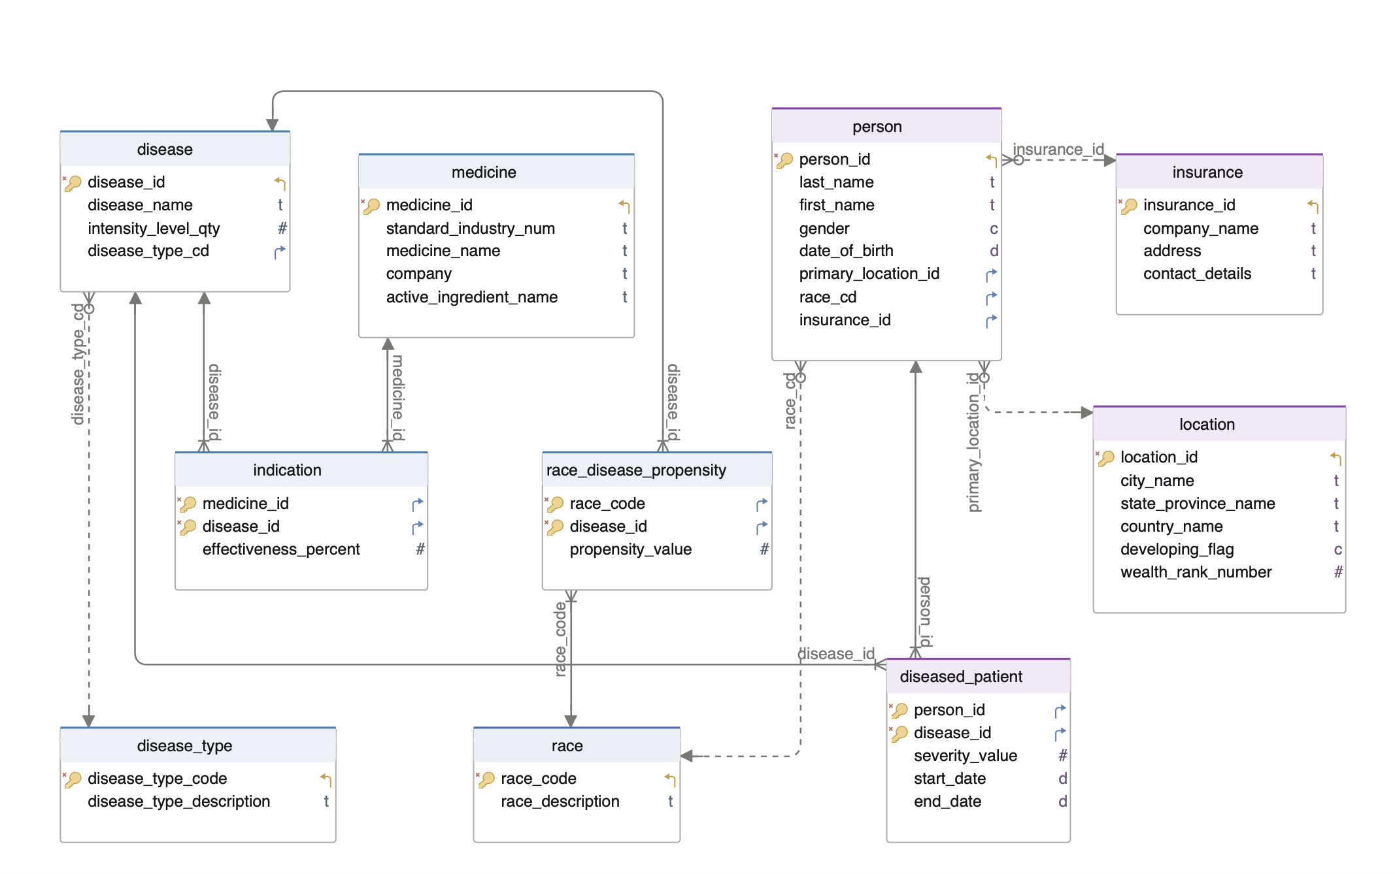
Disease ER Diagram

Slide 5
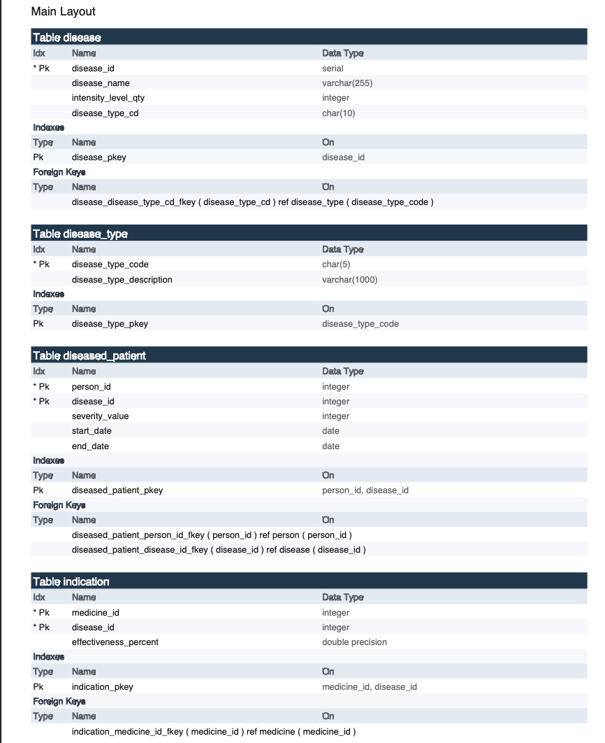
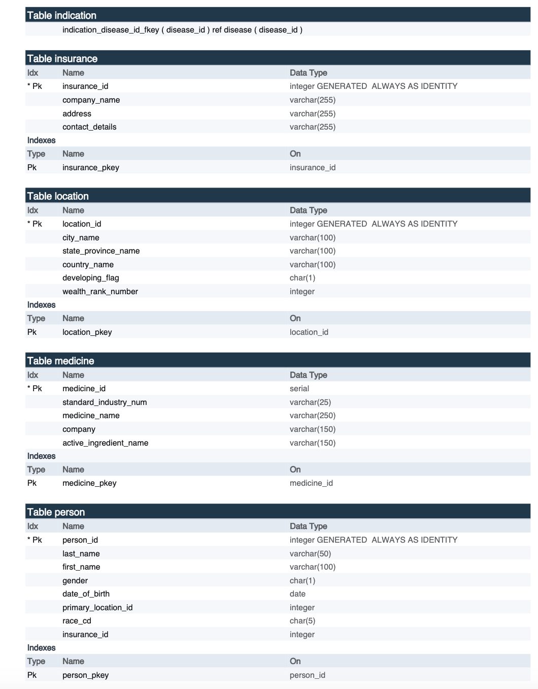
Database Data Dictionary

Slide 6
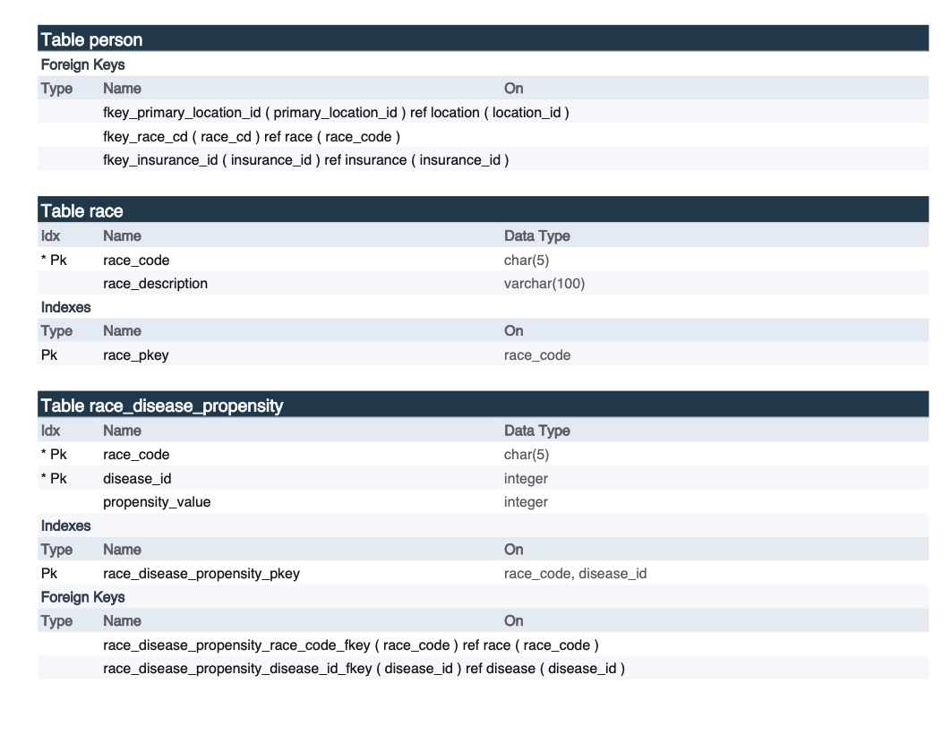
Data Dictionary

Slide 7
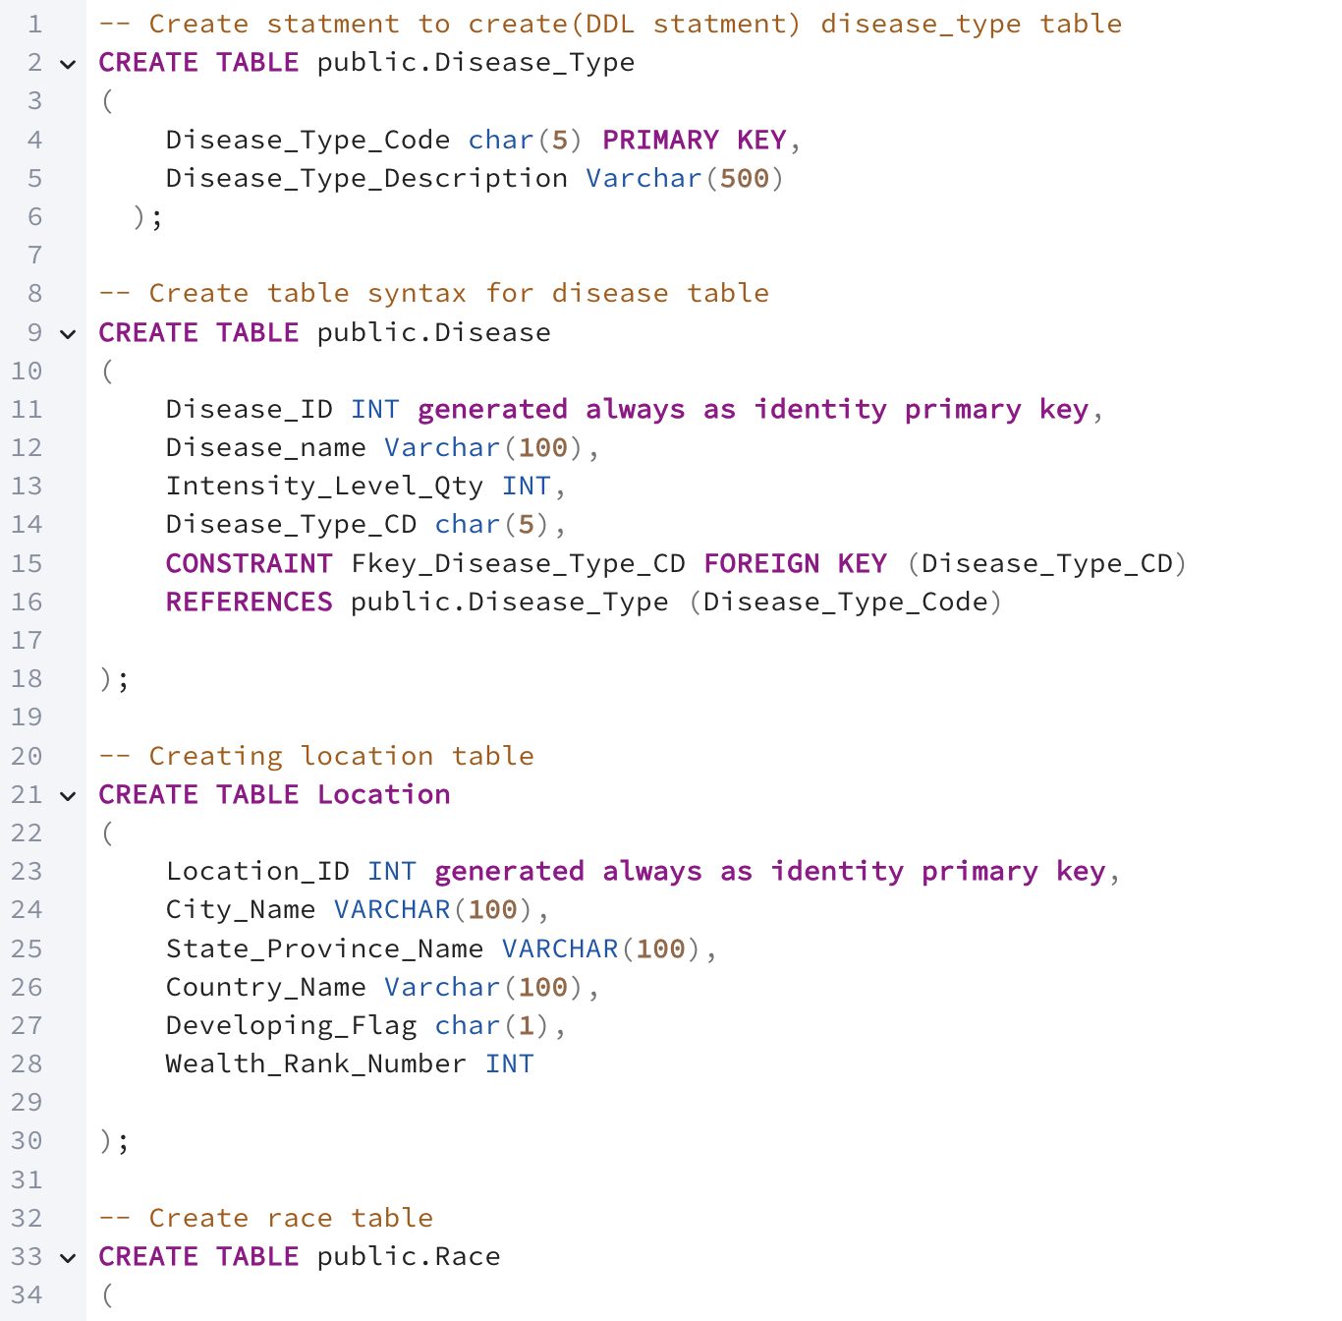
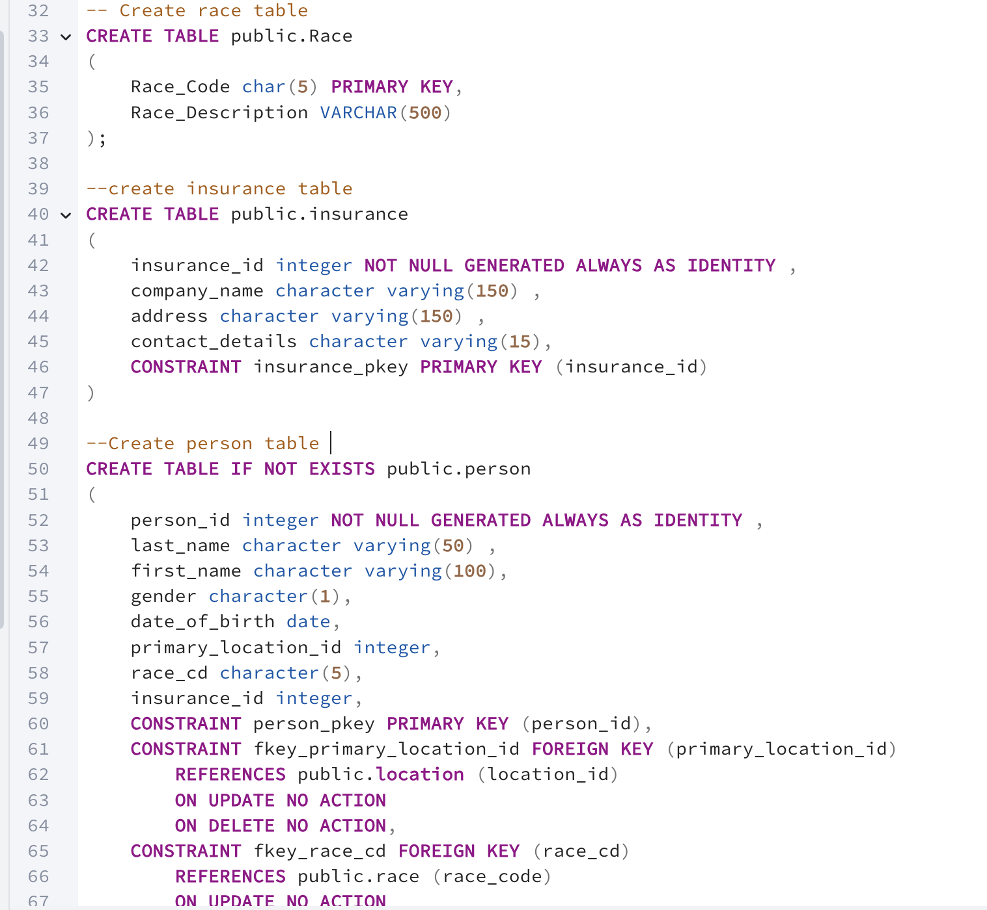
Data Definition Language

Slide 8
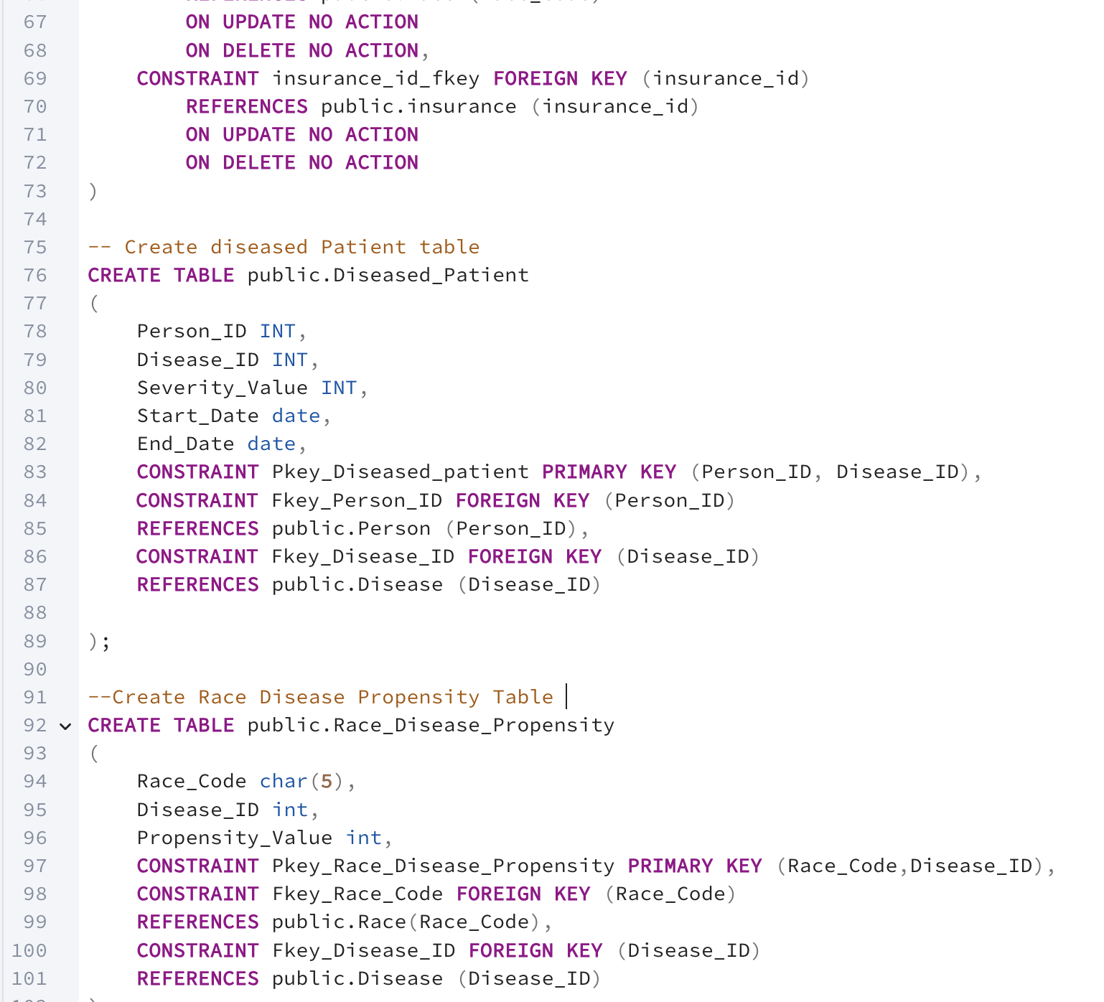
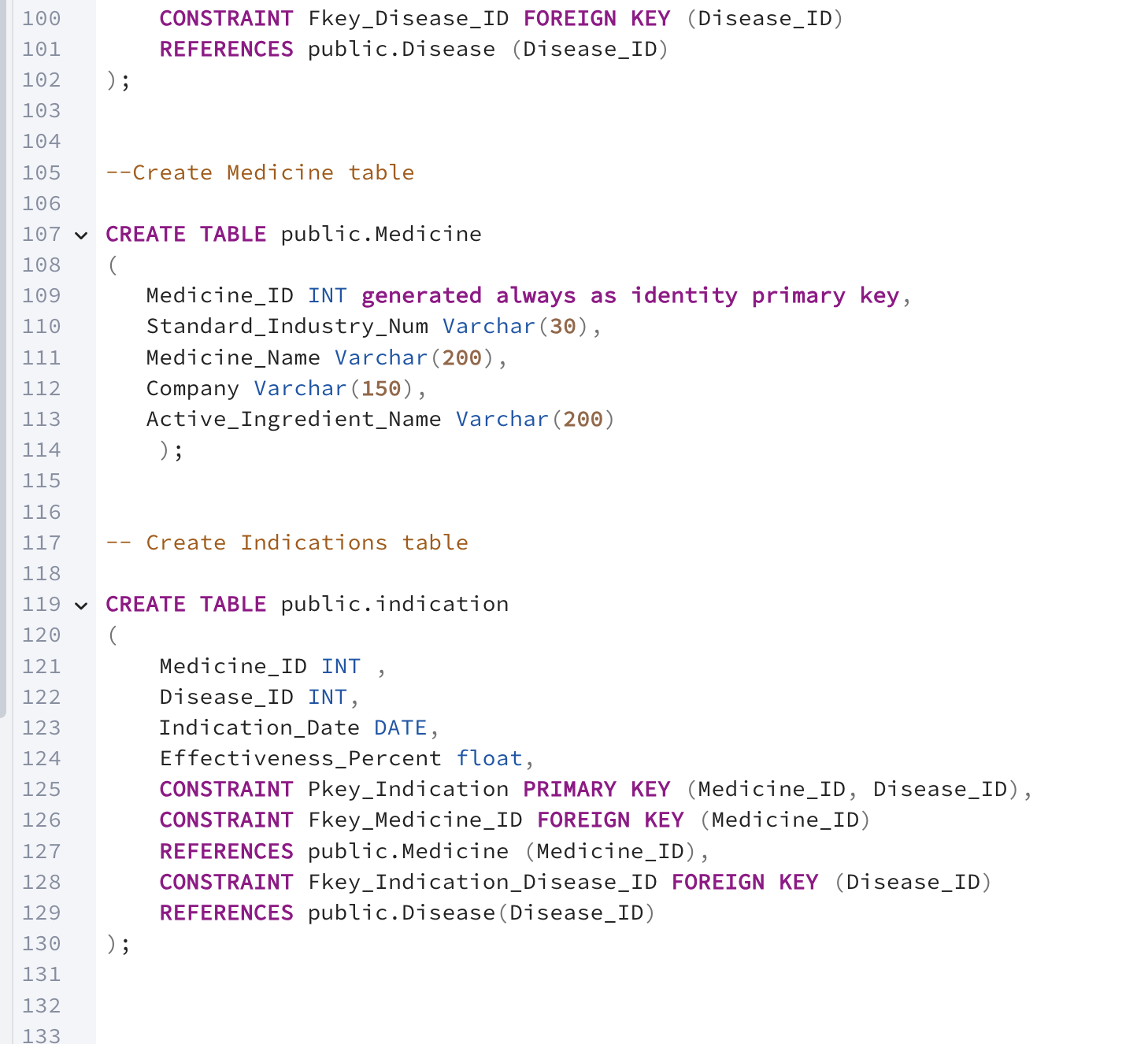

Slide 9
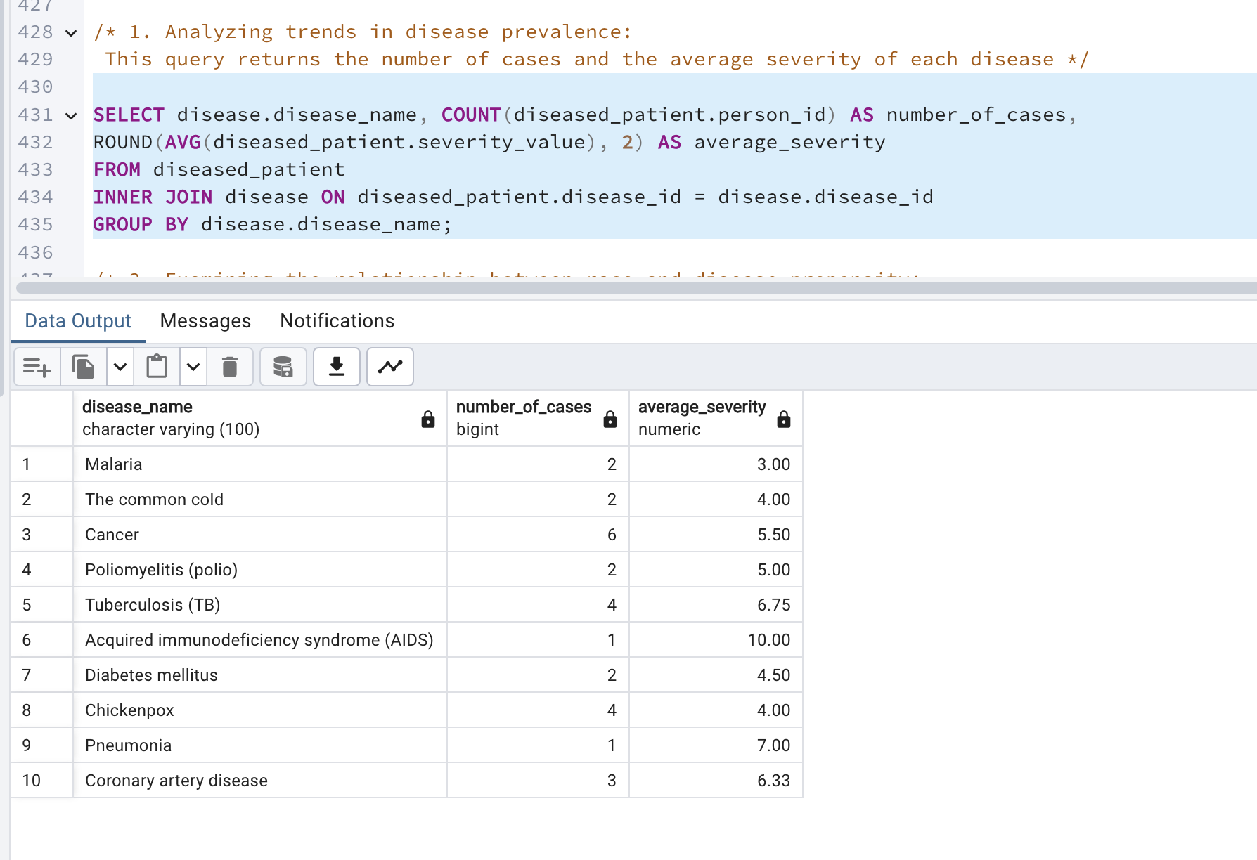
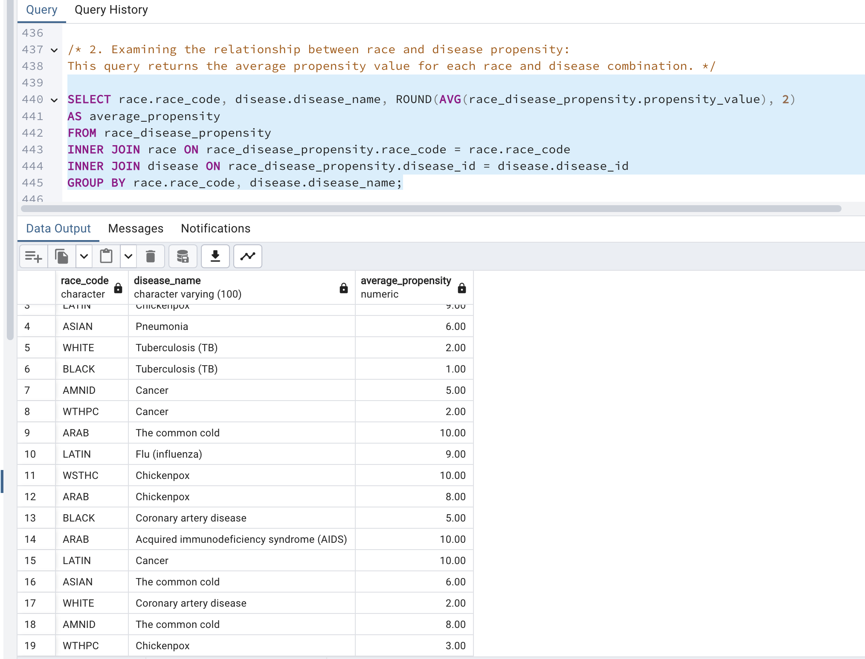
Operational Queries
1. Analyzing trends in disease prevalence: This query returns the number of cases and the average severity of each disease.
2. Examining the relationship between race and disease propensity: This query returns the average propensity value for each race and disease combination.

Slide 10
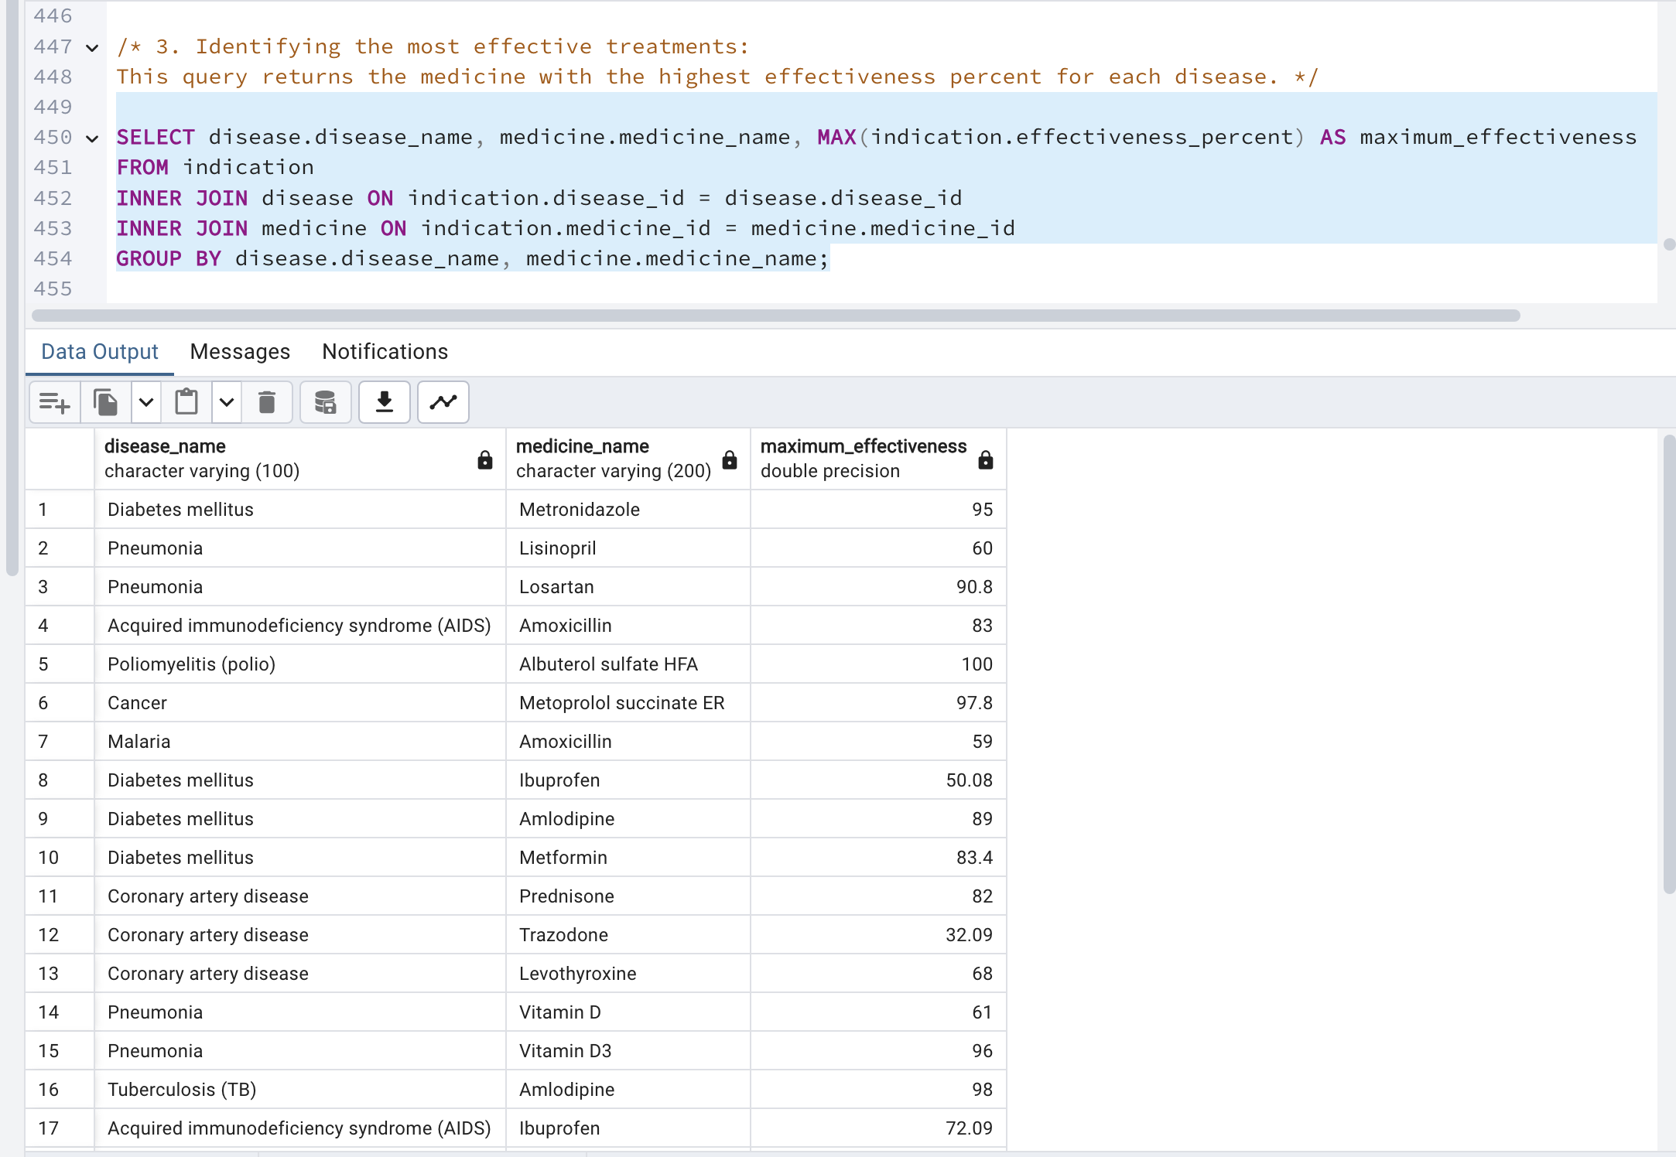
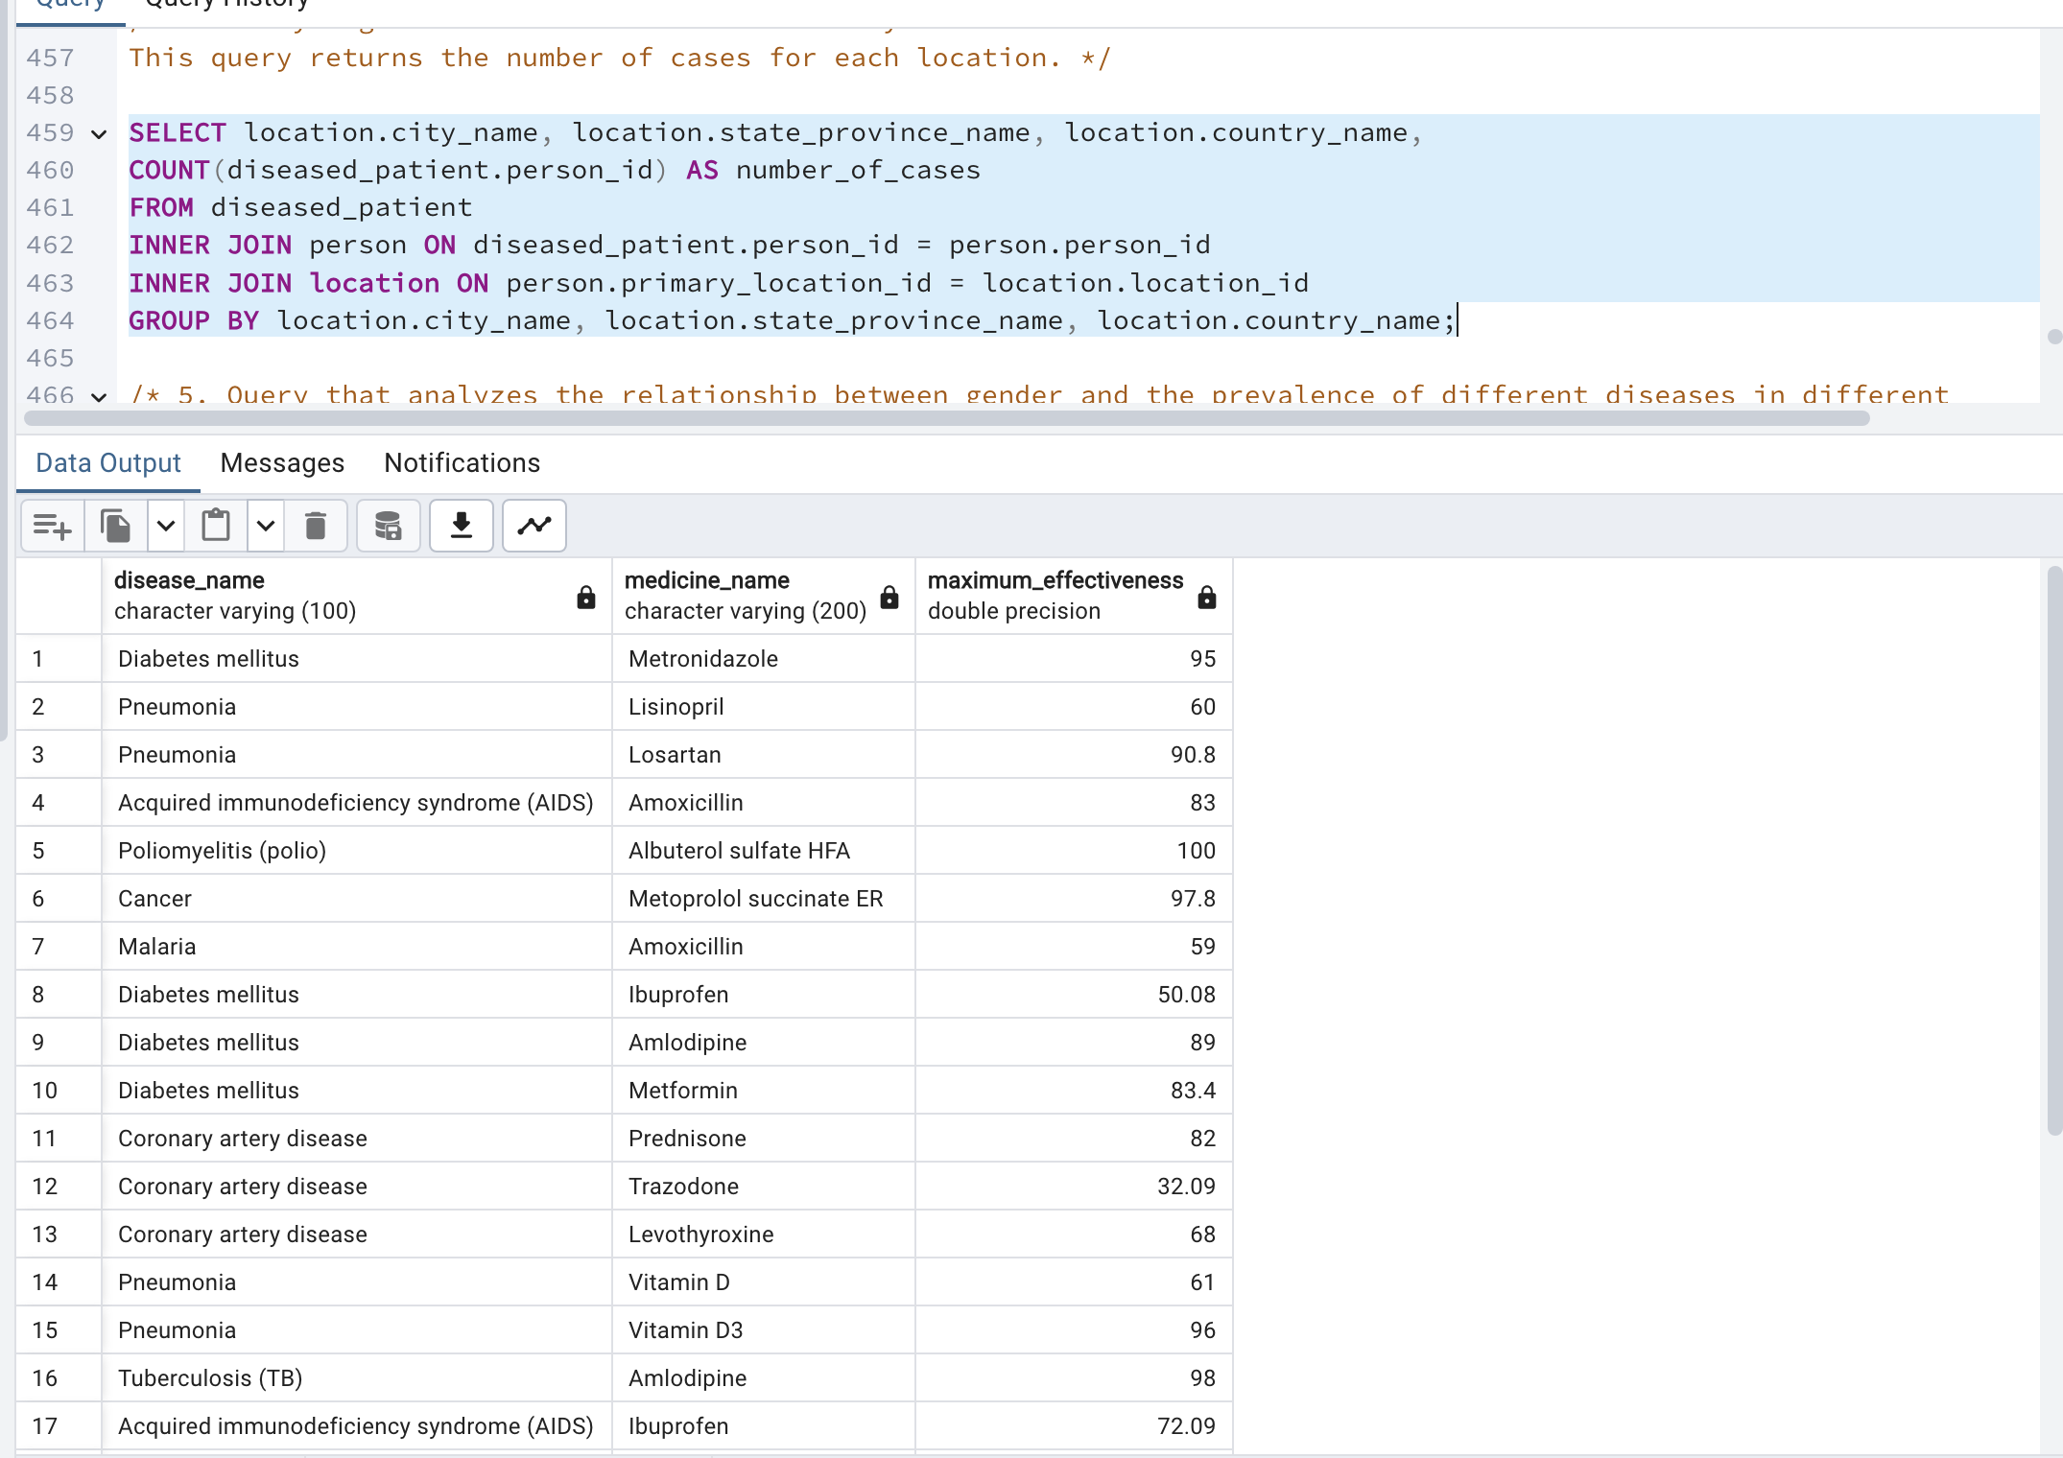
3. Identifying the most effective treatments: This query returns the medicine with the highest effectiveness percent for each disease.
4. Analyzing the distribution of diseases by location: This query returns the number of cases for each location.

Slide 11
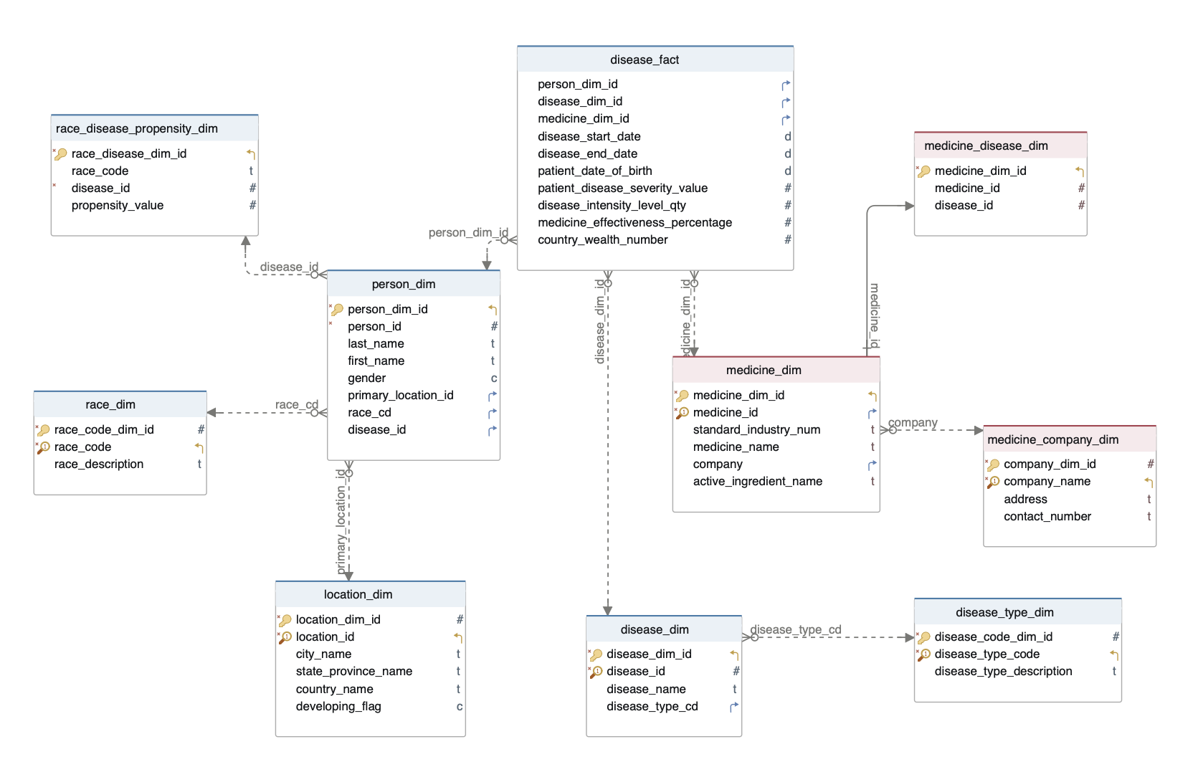
Snowflake Disease Model

Slide 12
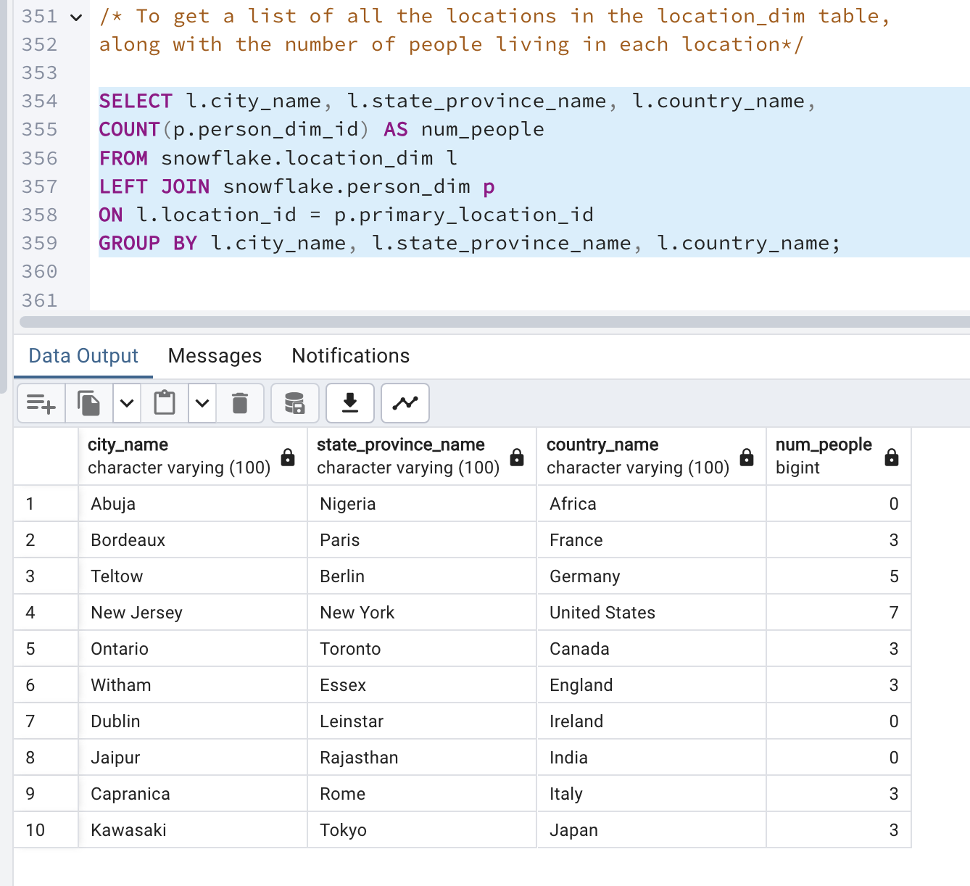
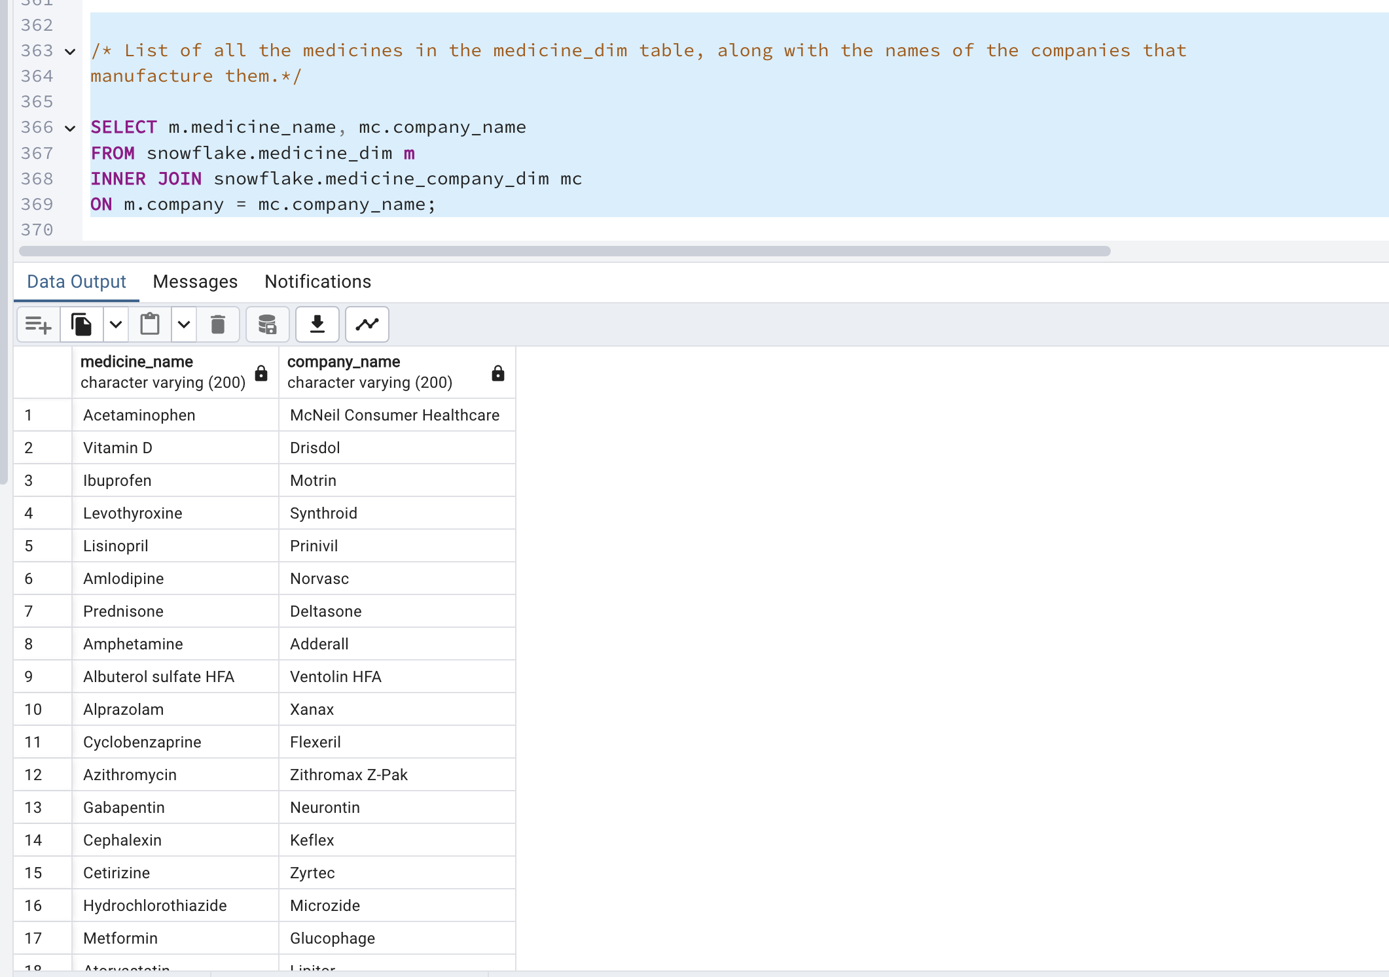
Analytical queries
1. To get a list of all the locations in the location_dim table, along with the number of people living in each location.
2. List of all the medicines in the medicine_dim table, along with the names of the companies that manufacture them.

Slide 13
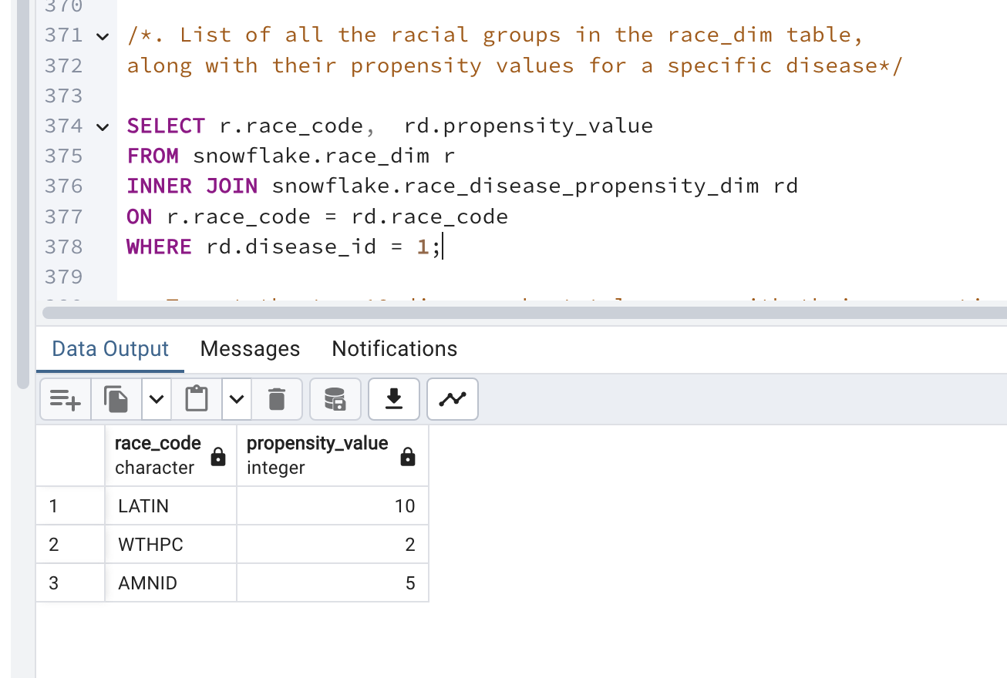
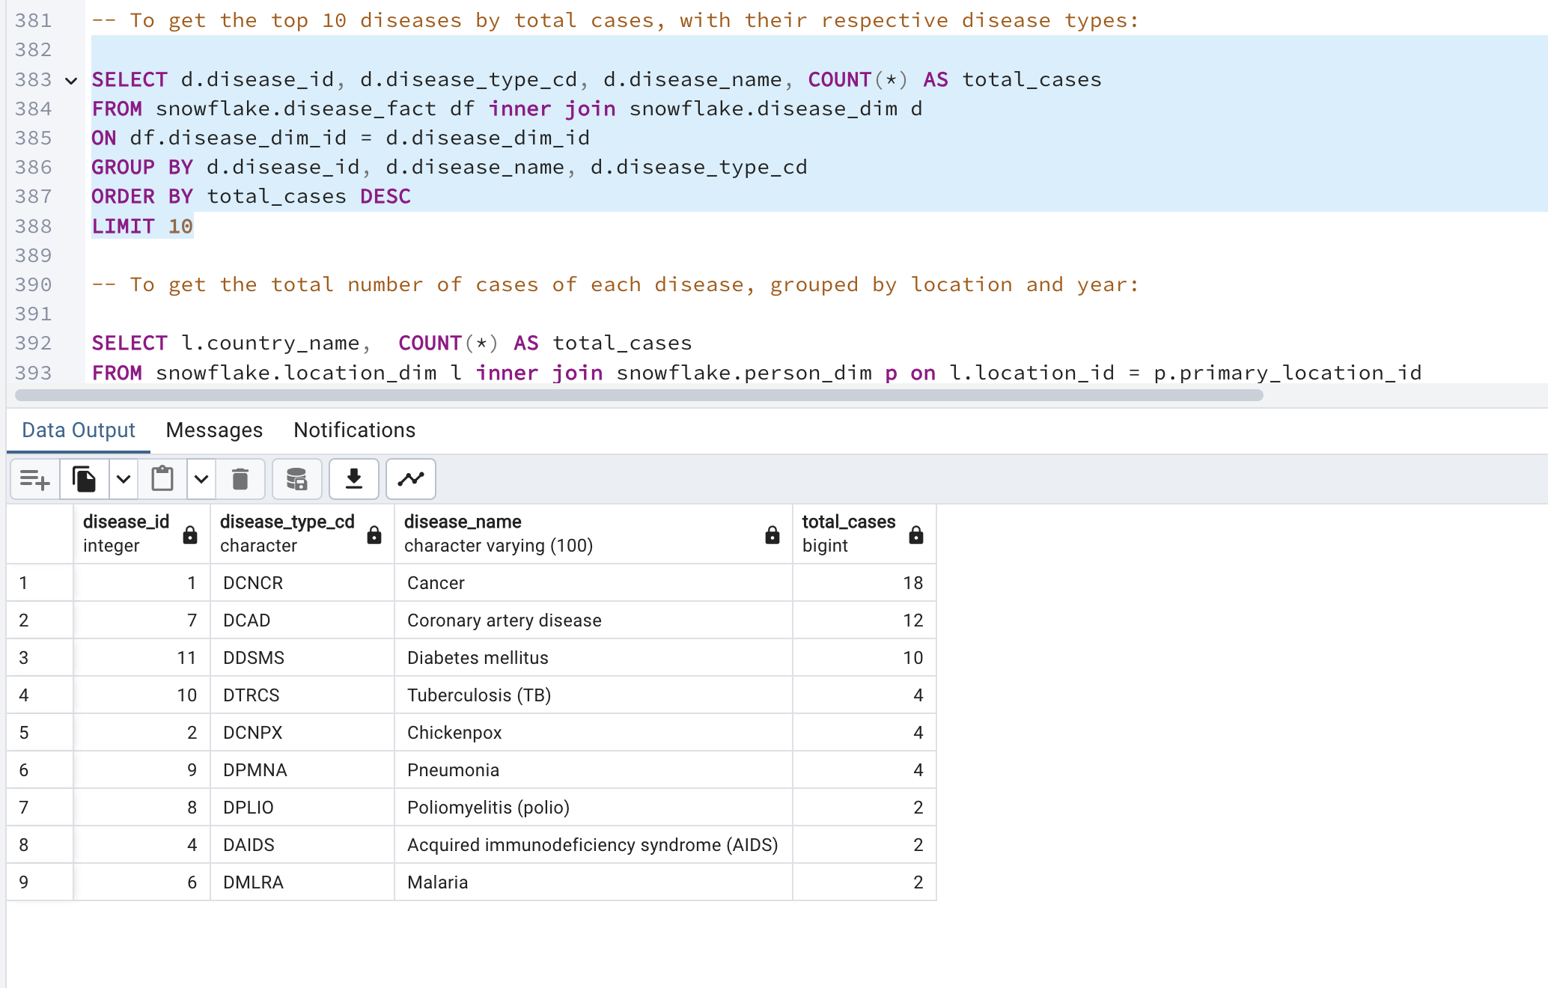
Analytical queries
3. List of all the racial groups in the race_dim table, along with their propensity values for a specific disease.
4. To get the top 10 diseases by total cases, with their respective disease types:

Slide 14
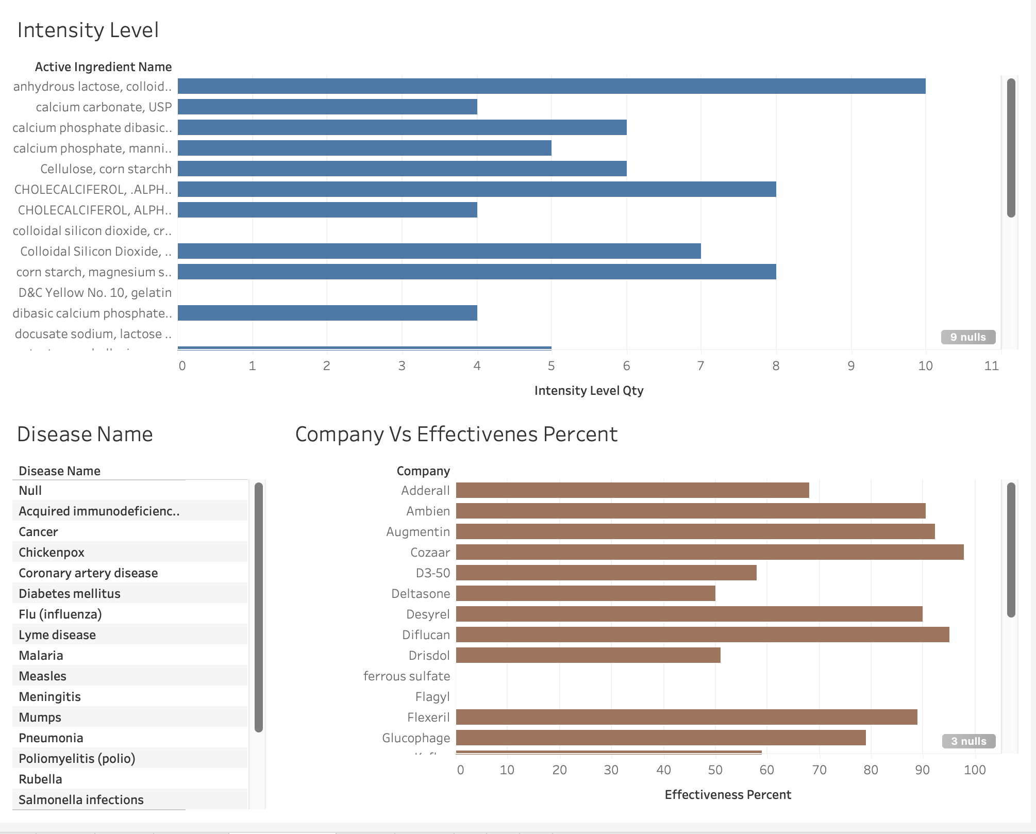
Dashboard Representation

Slide 15
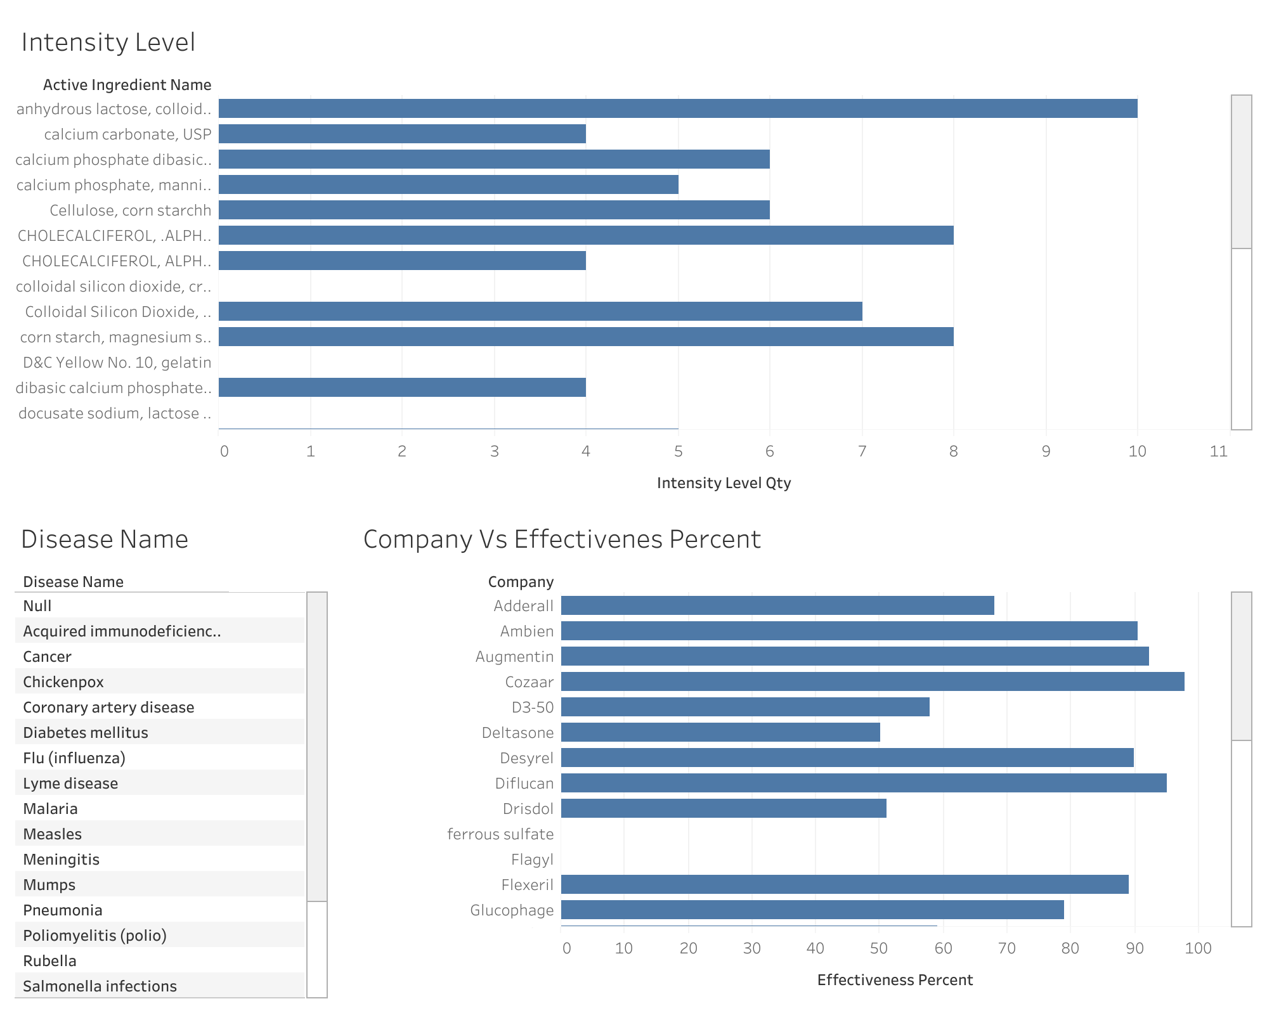
Dashboard Representation
Overview of what the graph indicates for a few specific ingredients:
Anhydrous lactose, colloidal: Has the highest intensity level, nearing 10 units on the x-axis.
Calcium carbonate, USP: Shows an intensity level of just above 4 units.
Several ingredients like calcium phosphate (dibasic and mannitol) and CHOLECALCIFEROL (ALPHA D-) have intensity levels in the mid-range, around 4 to 6 units.
This chart is useful for quickly assessing which ingredients have higher usage intensity compared to others within a given formulation or set of products.

Slide 16
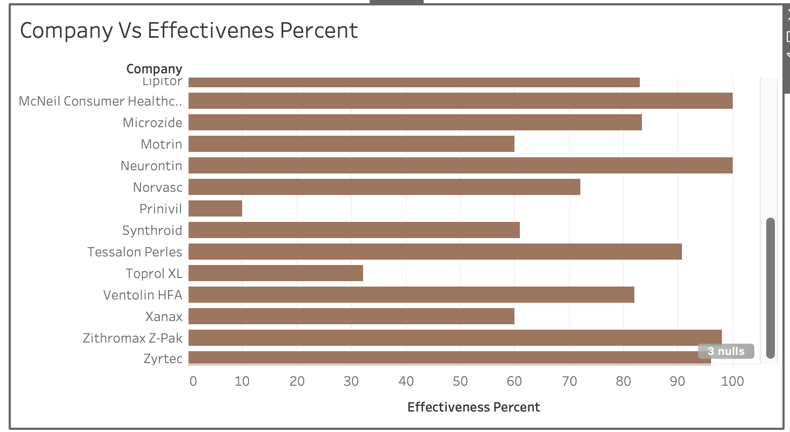
Dashboard Representation
Observations from the graph include:
Products Listed: The graph includes a variety of well-known medications, such as Lipitor, Motrin, Synthroid, and Xanax. Each bar corresponds to one medication.
Effectiveness Range: The effectiveness percentages of these medications vary widely. Some medications have very high effectiveness ratings, approaching or reaching 100%, while others are significantly lower.
Visualization Use: This type of visualization is useful for quickly comparing the relative effectiveness of different medications, potentially aiding healthcare professionals, patients, and researchers in making informed decisions based on treatment efficacy.
This chart is particularly useful for stakeholders in the healthcare industry to assess and compare the performance of different medications on a standardized effectiveness scale.

Slide 17
NoSQL
NoSQL databases are very flexible, easy to use, developer-friendly, and provide higher performance. These types of databases are a much better option when −
If you have Big Data Applications that handle large volumes of unstructured data.
If you need to scale the database based on constantly changing requirements
If you need the flexibility to store different types of data
How the structure of Disease Model database would be different in a specific NoSQL
For example, the "disease_type" collection might contain documents with the following structure:
{ "code": "D01", "description": "Cancer" }
{ "code": "D02", "description": "Diabetes" }
The "disease" collection might contain documents with the following structure:
{ "_id": 1, "name": "Breast Cancer", "intensity_level": 3, "type_code": "D01" }
{ "_id": 2, "name": "Type 2 Diabetes", "intensity_level": 2, "type_code": "D02" }

Slide 18
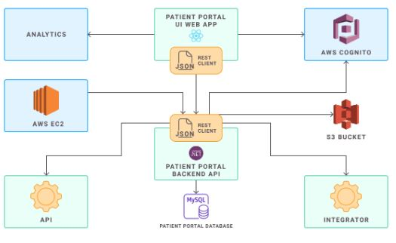
Architecture and Process
Our application uses a mix of services from Amazon Web Services (AWS), which helps us adapt to different needs and scale efficiently.

Slide 19
Application uses Amazon Web Services (AWS) EC2
How We Handle Computing and Processing:
AWS EC2: We start with Amazon EC2 instances that act like our own personal computers in the cloud. This is where we host our servers. Managing these requires a bit of hands-on work, especially around security and scaling up when more people use our app.
AWS Lambda: Alternatively, we also use AWS Lambda for some tasks. Lambda is pretty cool because it lets us run code without worrying about the servers at all. It automatically manages the computing resources we need. This is especially useful for tasks that need to adjust quickly to changing demands without any manual interference.

Slide 20
Advantages of Snowflake Data Warehouse Schema
Snowflake is a cloud-based data warehouse that is designed to make it easy to store, query, and analyze data. There are several advantages to using Snowflake in your application:
Scalability: Snowflake is designed to scale seamlessly as your data grows, so you don't have to worry about running out of storage or processing power.
Performance: Snowflake uses a columnar storage model and advanced optimization techniques to deliver fast query performance.
Security: Snowflake offers a high level of security, with features such as data encryption, network isolation, and data masking to protect your data.
Integration: Snowflake integrates with a wide range of tools and platforms, making it easy to connect to your data from various applications and analytics tools.
Ease of use: Snowflake has a user-friendly interface and a SQL-based query language that is familiar to many developers.

Slide 21
THANK YOU

